Slide 1

MOBILE DATA ACQUISITON SYSTEM
MODA

Slide 2
MODA
In MODA There are Two types of Categories
1. No Test/Non-Approved Category
2. Complete/Non-Approved Category

Slide 3
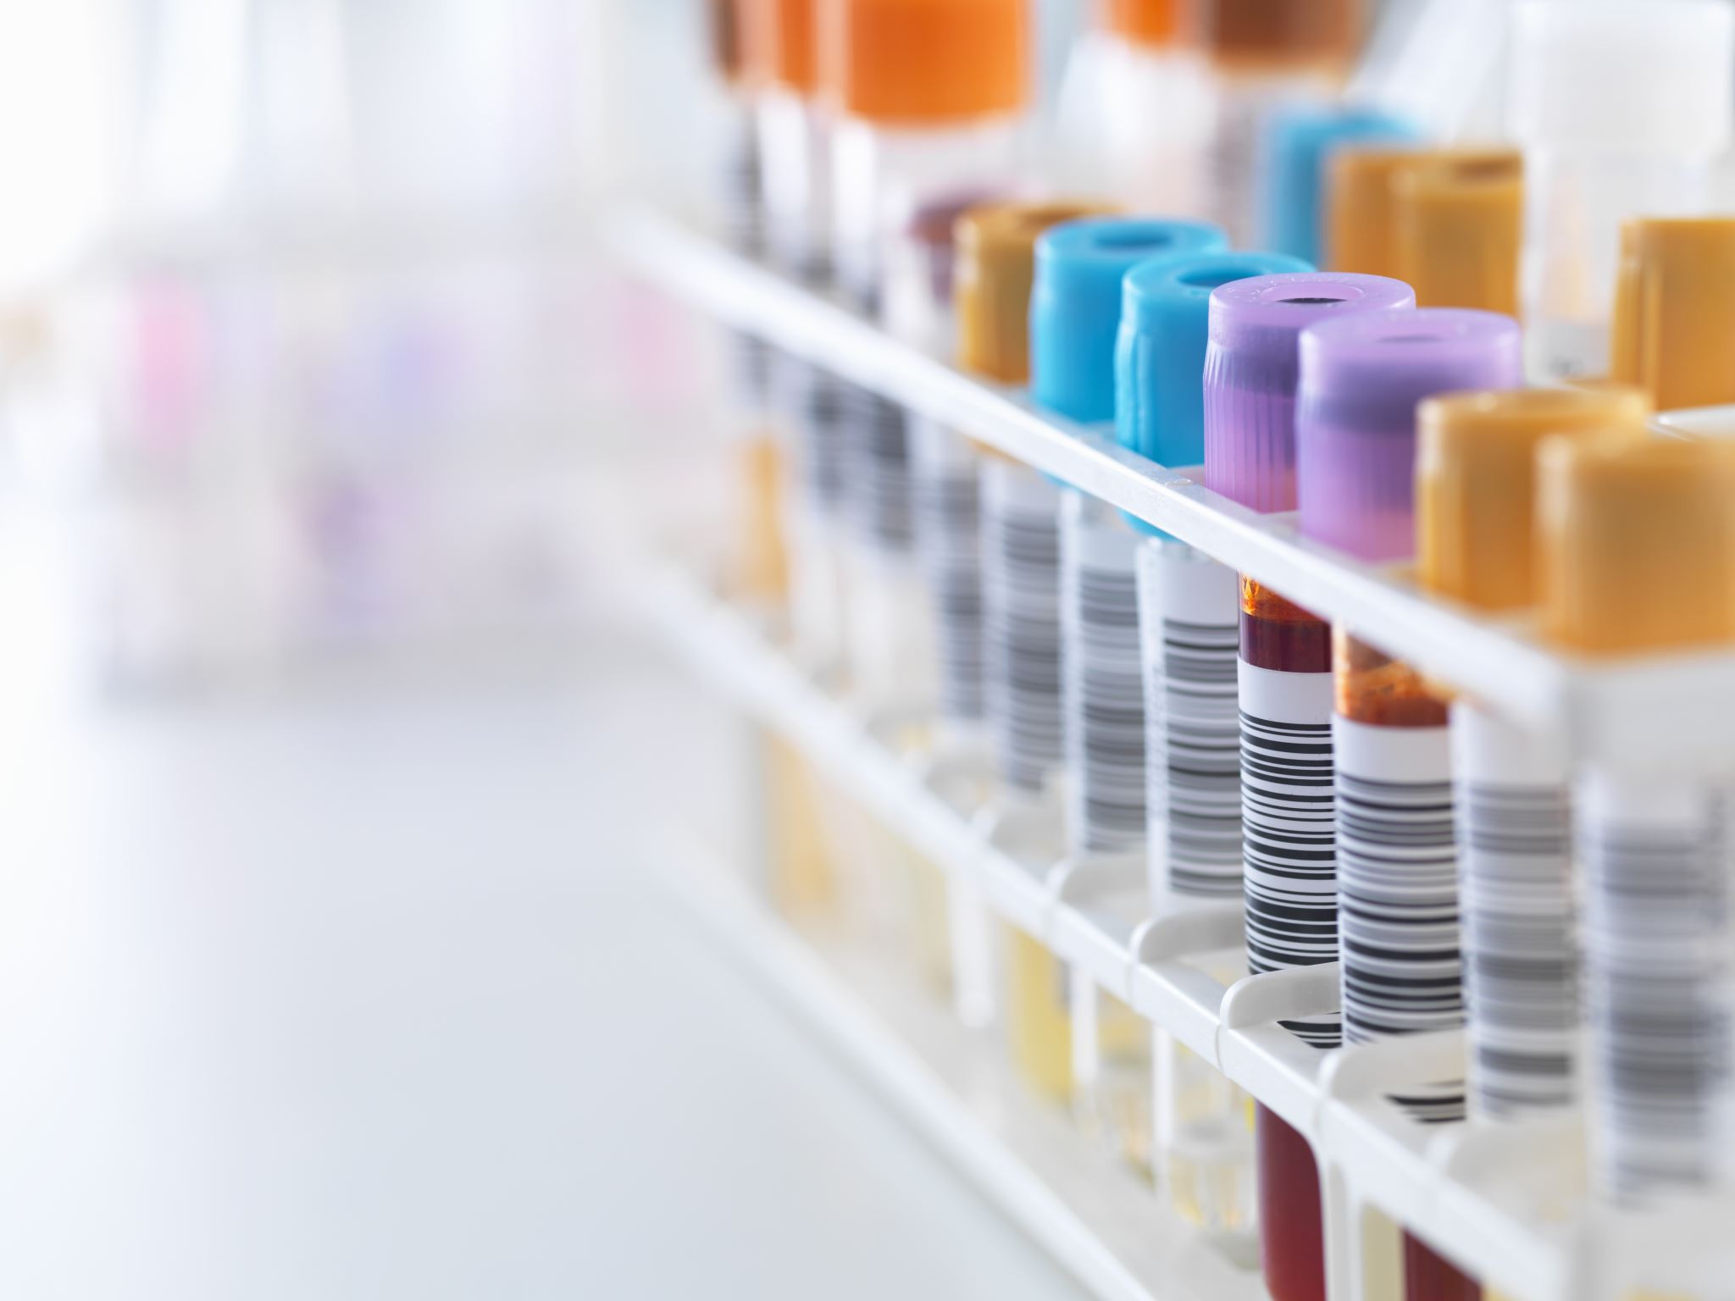
MODA
In Complete category we have different types of test methods,
Surface monitoring
Personnel monitoring
Active viable Air monitoring
Passive viable Air monitoring
Non-Viable particulate
Bioburden testing and Bioburden In-process
TOC & Conductivity
Compressed Air monitoring
Endotoxin Testing & In-process
Growth promotion
QC Chemistry Testing
Nitrate Testing

Slide 4
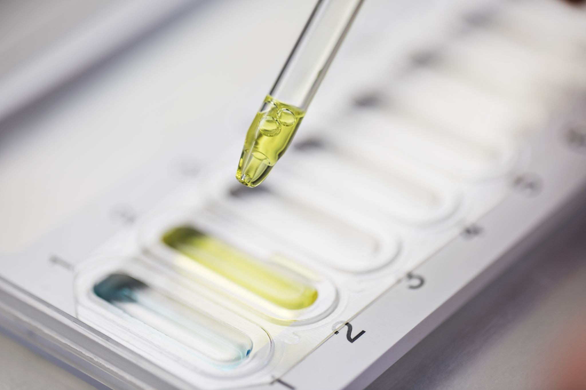
MODA
The Complete Category when we are approving the barcodes, we must check the Table Notes, Sampling, Media, Organism, Readings, Attachments, Testing tabs, Based on the different types of testing methods.
Table Notes- Check the Comment.
Sampling Tab- Check the Product Name and Lot Number.
Media Tab- Check the Media lot if it is Pass or Risk.
Organism Tab- Check the Organism, if Organism present or not.
Readings Tab- Check the Reading.
Testing Tab- Check the Testing Time and Date.
Attachments Tab- Check the Organism, Readings, Picture conforming.

Slide 5
MODA
Different types of colour flag barcodes are there Blue, Yellow and Red, when we are approving the colour barcode, we have to check Table notes, Media, Sampling, Organism and Attachment tabs.
In Surface Monitoring, Personnel Monitoring, Active and Passive viable, Bioburden, Growth promotion, Compressed Air monitoring, Endotoxin, QC testing, Nitrate testing test methods check the Table notes, Media, Sampling tabs.
In TOC & Conductivity test method check the Table notes, Media, Sampling, Testing and Attachment tabs.

Slide 6
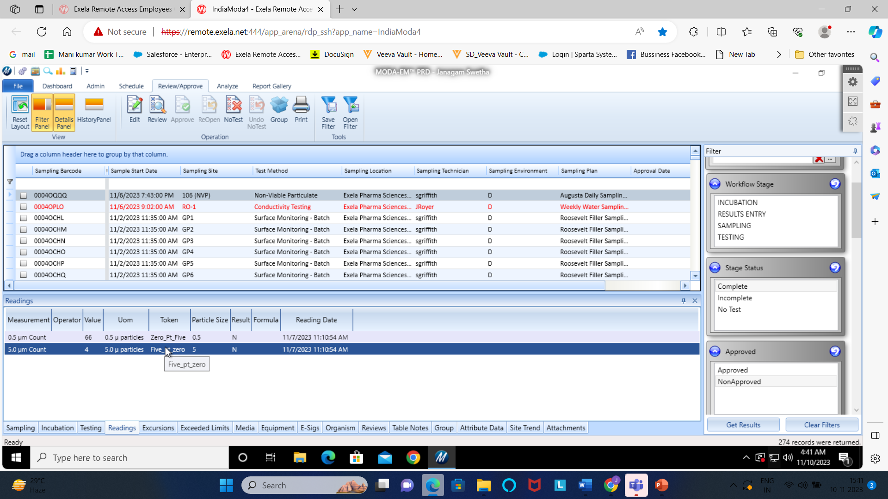
MODA
In Non-Viable Particulate test method check the Table notes, Media, Sampling, Readings and Attachment tabs.
In Non-Viable particulate Test method, we must check the Readings in Readings tab, the readings present in that tab should be match with the readings present in the attachment tab readings, then we can approve if not it should be a finding.

Slide 7
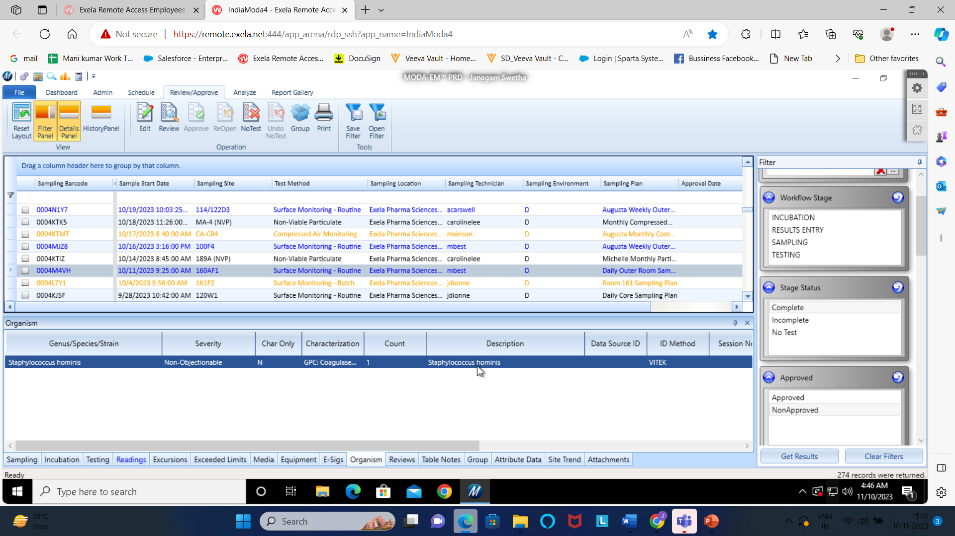
MODA
In Blue colour barcode we must check the Sampling, Media, Organism and attachment tabs. The Organism present in that tab should be match with the Organism present in Attachment tab. If it is not matching, we should not approve.

Slide 8
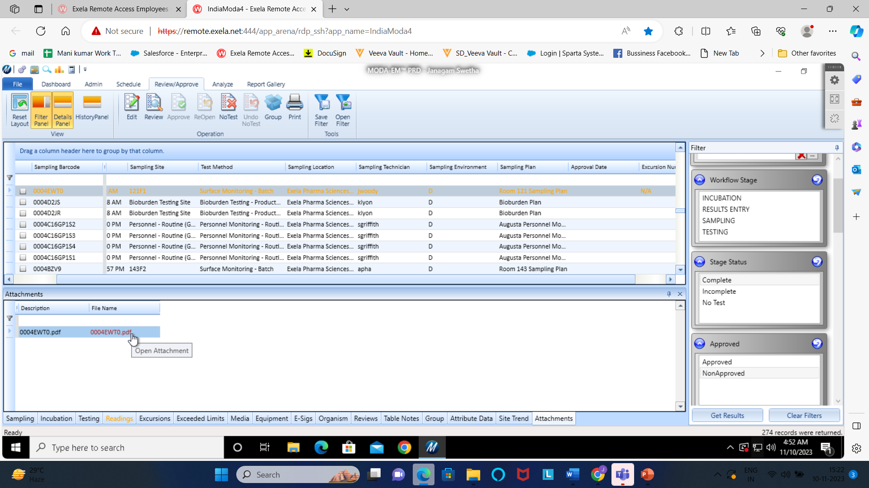
MODA
Red and Yellow Barcodes, check the Sampling, Media, Table notes, Organism, Attachment Tabs. and in Excursion column they must mention N/A or Excursion number, and in attachment tab, the organism should match with the Organism present in Organism Tab and the picture conforming should be present in attachment tab. If it is not present, we should not approve.

Slide 9
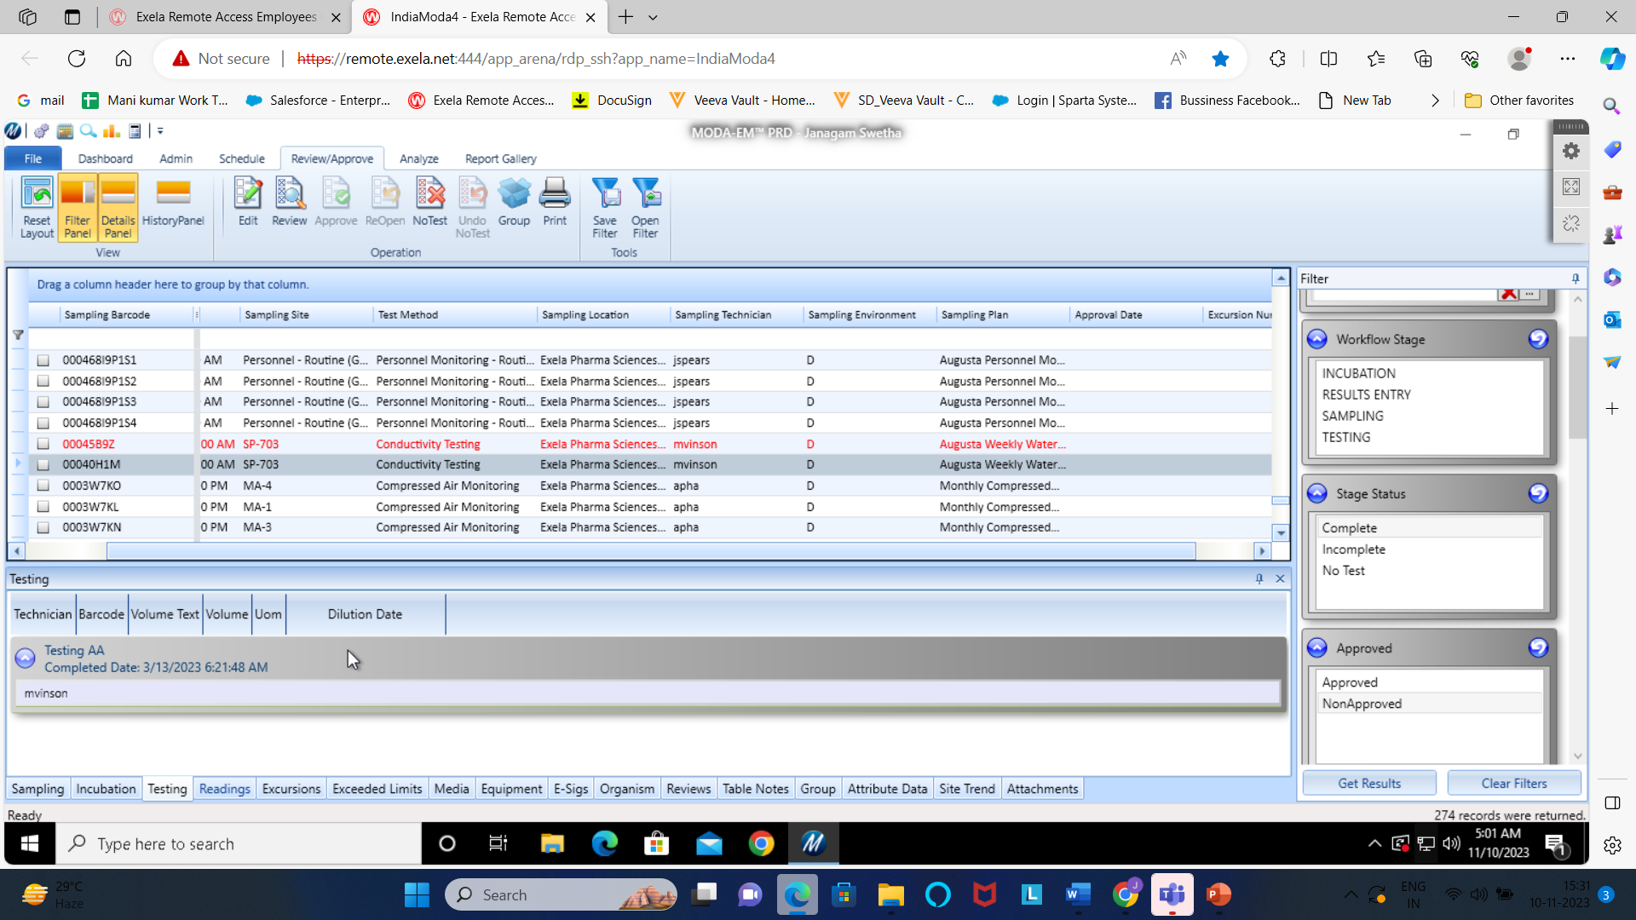
MODA
In Conductivity test method we must check Table notes, Media, Testing, Sampling and Attachment tabs. In Conductivity the Attachment date should be match with the Testing date.
In TOC test method, The date and Barcode should match with the Report present in the Attachment tab, If not we should not approve the barcode.

Slide 10

Thank you

